Slide 1
Student Attendance Management System
Web Technology Mini Project
2019 Pattern
A.Y.2021-22
T.E. Semester -II

Slide 2
Contents
Team members detail
Objectives
Technical Details
Output Snapshot
Conclusion

Slide 3
Team members detail
Sr. No. | Roll No. | Student Name
1 | TC23 | Gunjan Kinger
2 | TC66 | Vishwajeet Patil

Slide 4
Objectives
To develop a System which will help to ease out the Manual Attendance taking system and for students will ease the process to view the attendance anytime

Slide 5
Technical Details
Platform: XAMPP, VS code.
Languages: The frontend is built in HTML, CSS and JS. PHP is used for integration with frontend.
Client Side: JavaScript
Database Connectivity: MySQL

Slide 6
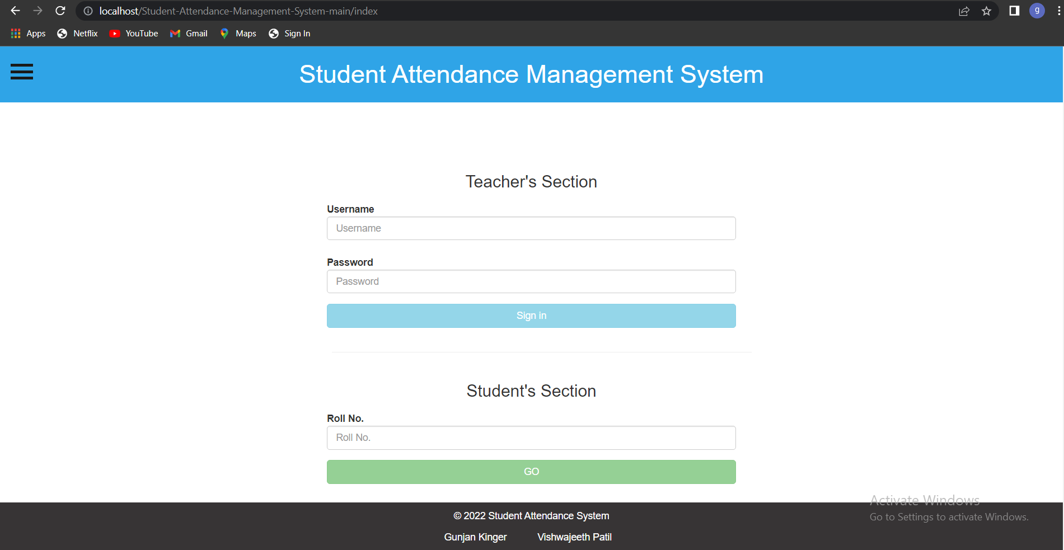
Output Snapshot
Login page

Slide 7
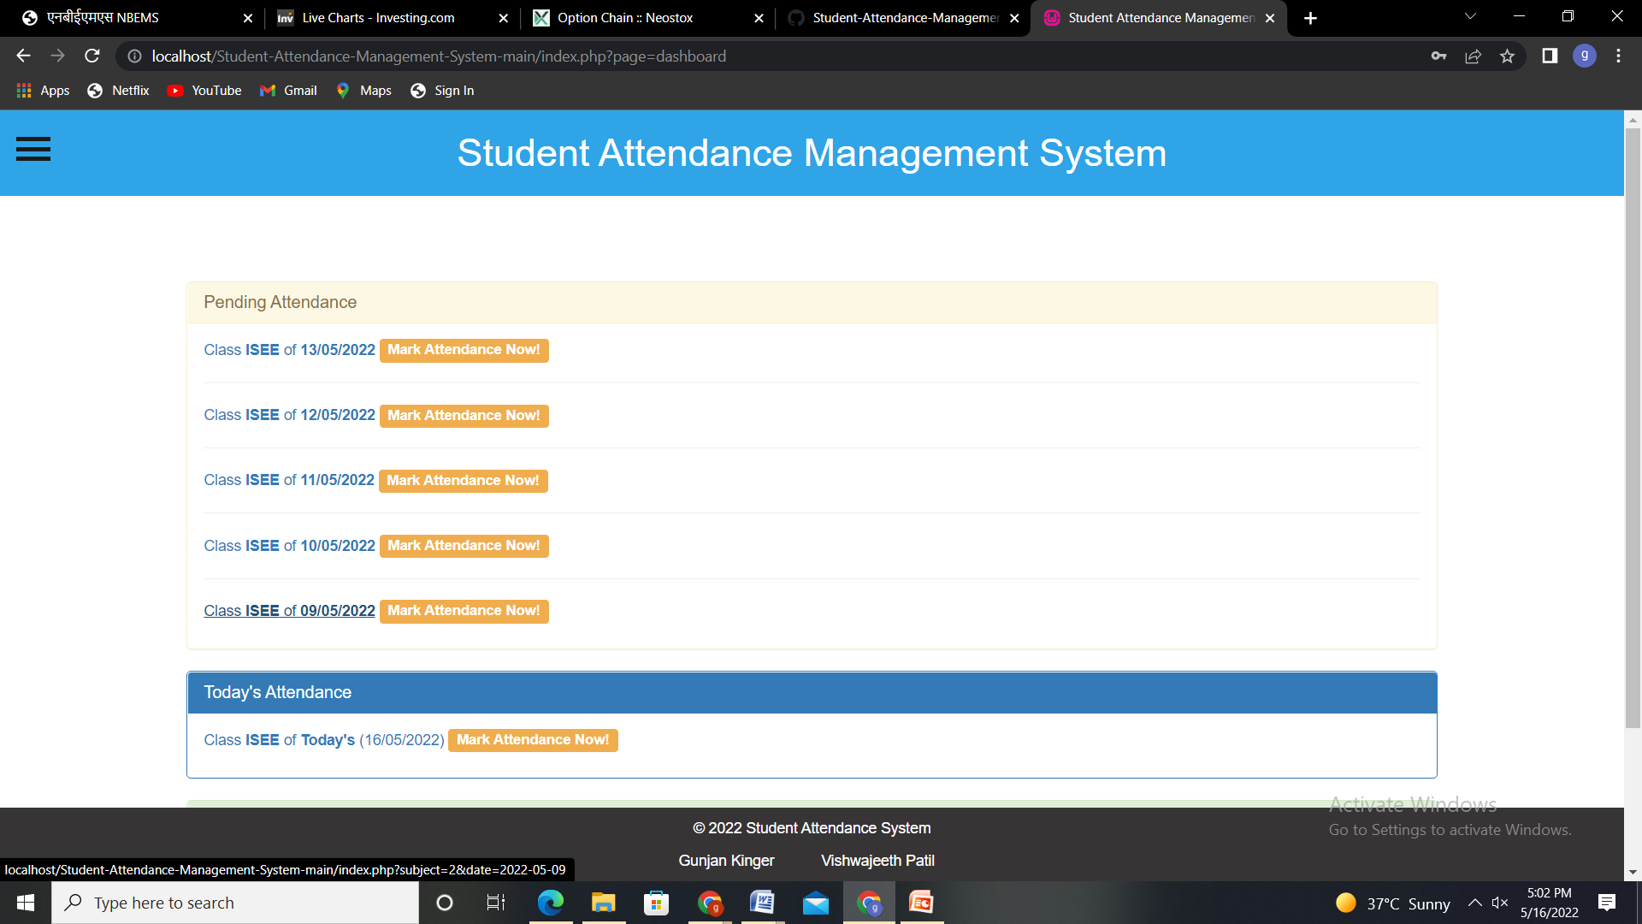
Teachers Section

Slide 8
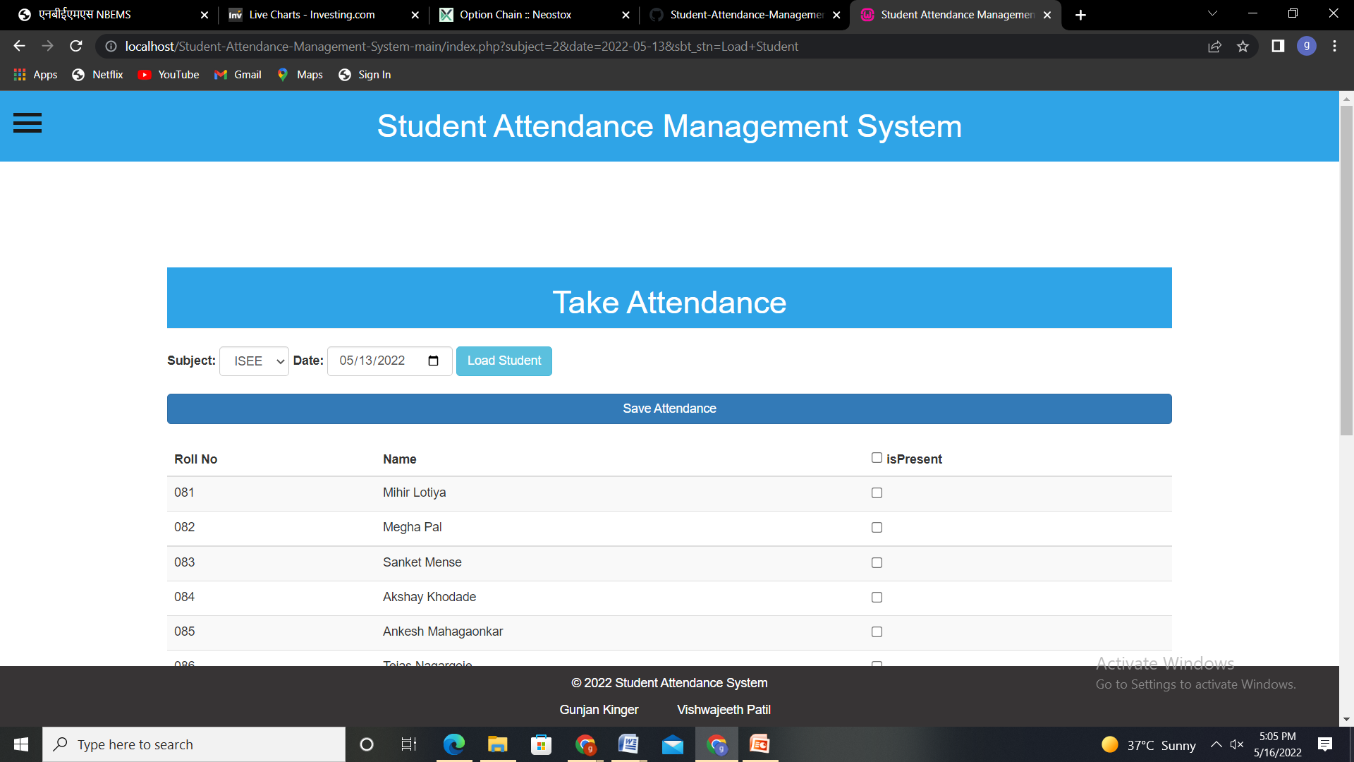
Attendance Sheet

Slide 9
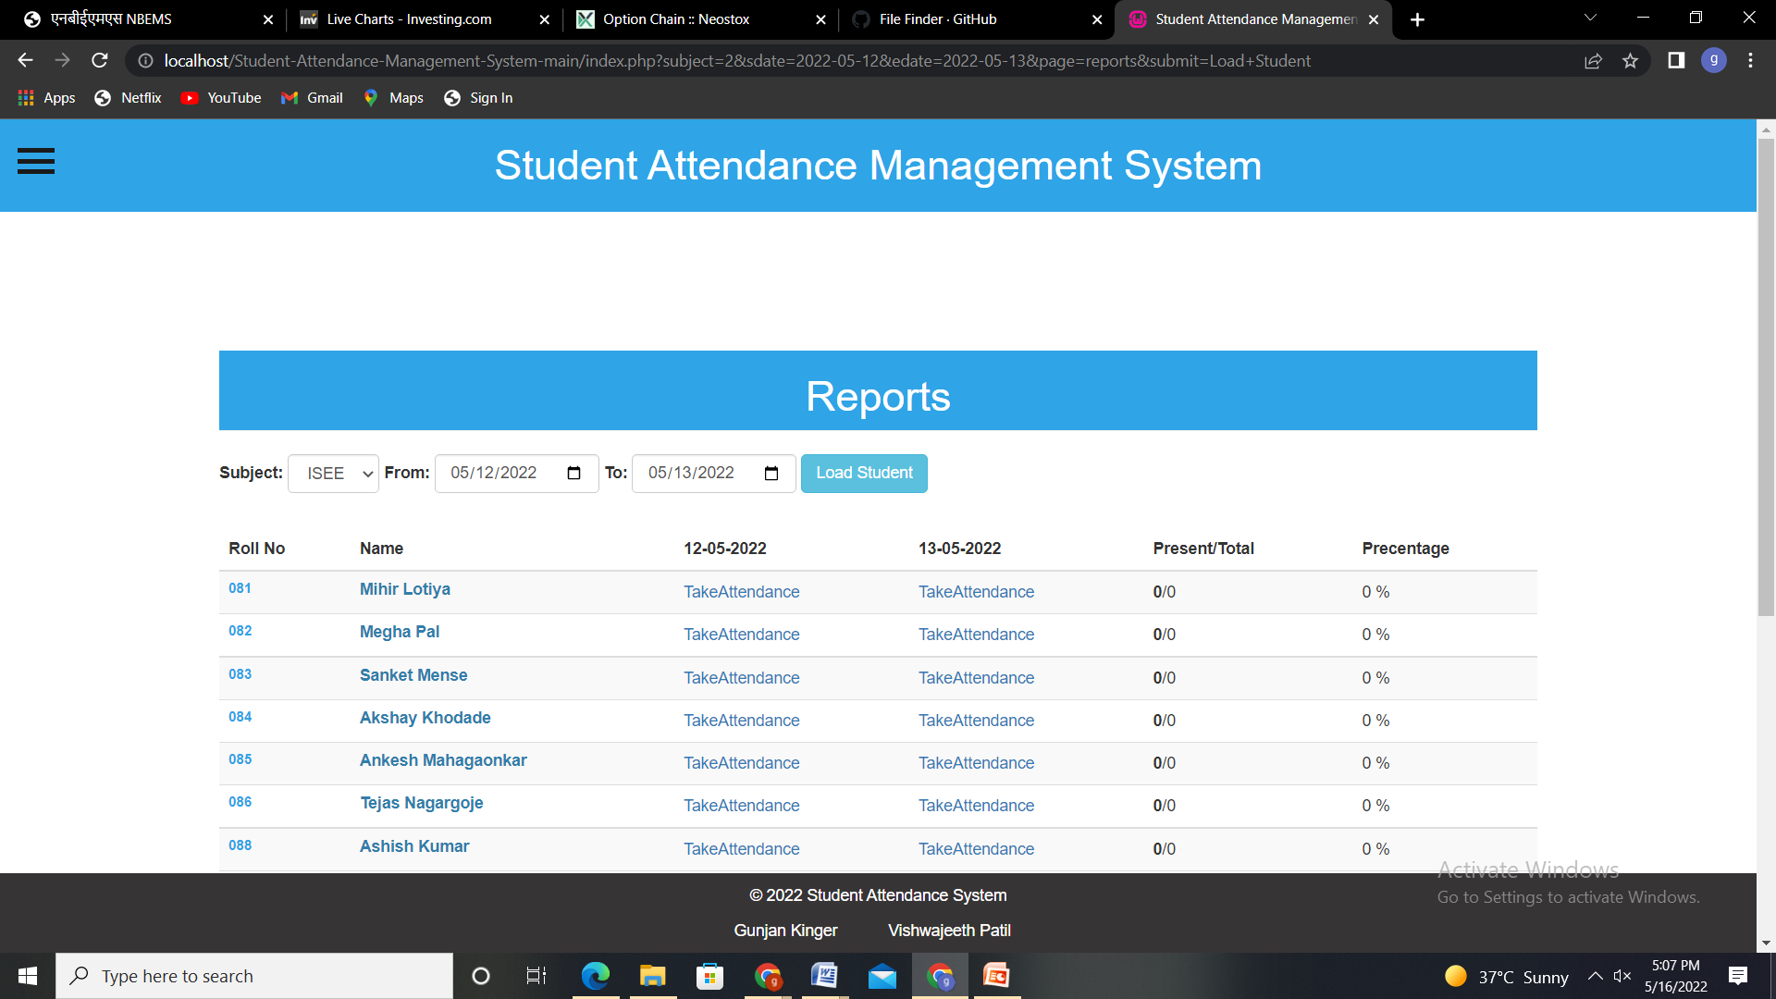
Reports

Slide 10
Conclusion
Finally, in the student attendance management system, the outcome of all the hard work done for the attendance management system is here. It is software that helps the user to work with the attendance, etc. This software reduces the amount of manual data entry and gives greater efficiency.

